Slide 1
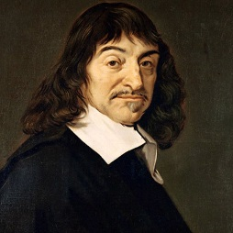
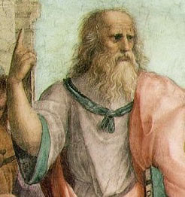
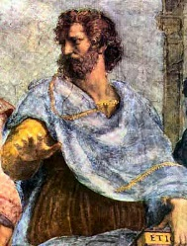
The Philosophy of Psychology
Rationalism
Socrates
(469-399 BCE)
Plato
(427-347 BCE)
Descartes (1596-1650)
“I think, therefore I am”
(“Cogito, ergo sum”)
Dualism – mind(soul)/body
Reflex Arc
Aristotle
(384-322 BCE)
Empiricism
Cont’d

Slide 2
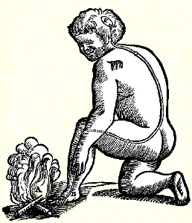
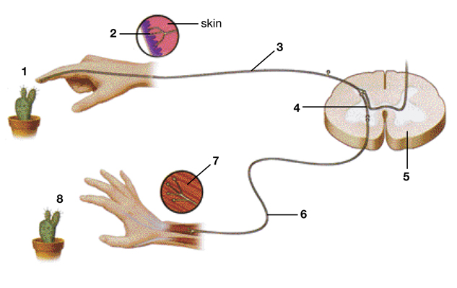
The Reflex Arc - Descartes

Slide 3
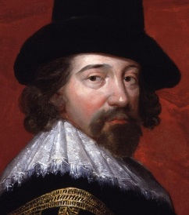
Empiricism
Francis Bacon (1561-1626)
“Scientific Method”
“Knowledge is power”
Locke, Hume, Berkeley
(1600s-1700s)
“Tabula Rasa”
The Science of Psychology

Slide 4
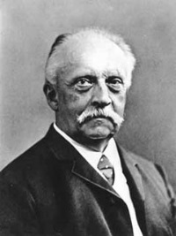
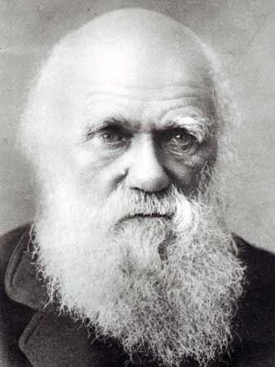
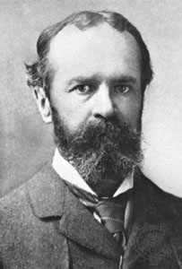
The Science of Psychology
Helmholtz (1821-1894)
Sensory processing
Nerve physiology
Monism – “Unity of body and mind”
Rationalism
Structuralism
Empiricism
Wundt (1832-1920)
Titchner (1867-1927)
Introspection
First Psychology Lab (1879)
Functionalism
Charles Darwin
Evolution by Natural Selection (1859)
“Survival and Reproduction”
William James
Pragmatism
Radical Empiricism
First American Psychology Lab (1875-1880)

Slide 5
Gestalt Psychology (1890)
“The whole is different than the sum of the parts”
Kohler
Koffka
Wertheimer
Structuralism
Behaviorism (1920s)
B.F. Skinner
John Watson
Functionalism
Conditioning
Ivan Pavlov (1927)

Slide 6
History of Psychology Quiz
1. Define each of the following:
Rationalism
Empiricism
Structuralism
Functionalism
How did each of these trends influence how we approach questions and issues in modern psychology?
Describe two infantile reflexes and discuss how the development of the brain influences these reflexes.
3. What is a ‘critical period’ in development? Give two examples and discuss the implications for an individual if the critical period for a system is disrupted in some manner.

